Slide 1
What is Social Stratification?
“A system in which groups of people are divided into layers according to their relative property, power, and prestige.”

Slide 2
Social stratification
Social stratification is the HEART of macrosociology (the study of whole societies)

Slide 3
social stratification
Exists within a society and between nations and affects our life chances and our orientation to life
  Slavery

Slide 4
social stratification
Exists within a society and between nations and affects our life chances and our orientation to life
  Slavery

Slide 5
Three Main Types of Social Stratification
Slavery – Causes and Conditions varied around the world
Caste – was India’s main system of formal stratification until 1948, boundaries are rigid
Class – The U.S. system of stratification, boundaries are fluid

Slide 6
Slavery
A form of social stratification in which some people own other people
  Debt
  Punishment
  Defeat in battle
    Slavery could be temporary or permanent and was necessarily passed down to ones children

Slide 7
Slavery
Temporary or permanent?
  Indentured service: a contractual system in which someone voluntarily sold his or her services for a specified period of time. When that time was up they were free to leave

Slide 8
Slavery
Shortage of indentured servants
  Enslavement, first the Indians then turned to the Africans who were being brought over by the British, Dutch, English, Portuguese and Spanish
  American’s wrote slavery into law so that you were now able to have a slave for life, since it was so profitable for us to own slaves.

Slide 9
Forced Labor and Slavery
Worldwide at least 12.3 million people are victims of forced labor, any work performed under threat of punishment and undertaken involuntarily.
  India, Pakistan, Bangladesh and Napa
  Agriculture, mining, prostitution, and factories

Slide 10
Forced Labor and Slavery
Slaves produce goods we use everyday, including sugar from the Dominican Republic, chocolate from the ivory coast, paper clips from China, carpets from Nepal and cigarettes from India.
  40%-50% of all victims of forced labor are children

Slide 11
Forced Labor and Slavery
Slavery expert Kevin Bales (1999) explained that slavery is linked to three factors:
    Rapid growth in population in the developing world.
    Social and economic changes that have displaced rural dwellers to urban centers.
    Government corruption that allows slavery to go unpunished, even though it is illegal in every country.

Slide 12
Slavery today
There is some debate as to whether or not slavery is still practiced in certain parts of the world today. Although denied by their governments, accusations have been made that the slave trade has been revived in Sudan and Mauritania
Slavery Today- child labor and human trafficking

Slide 13
Sex Slavery
Most common form of Labor in South Asia
  Some girls are forced into prostitution by their husbands, fathers, and brothers to pay family debts
  Other girls are lured by offers of good jobs and then forced to work in brothels under the threat of violence

Slide 14
Child Prostitution and Trafficking
In poor countries, the sexual services of children are often sold by their families in an attempt to get money.
Some children are kidnapped or lured by traffickers with promises of employment, only to end up in a brothel:
the U.S. Immigration and Naturalization Service identified 250 brothels in 26 American cities where forced prostitutes, including children are taken.

Slide 15
Child Prostitution and Trafficking
4 Worldwide it is estimated that there are about 1 million child prostitutes; in the U.S., 300,000.
5. Americans also engage in child-sex tourism abroad, particularly in Southeast Asia: in 240 identified cases in which legal action was taken against foreigners for sexually abusing children in this region, one-fourth of the violators were from the United States.

Slide 16
Child Labor
Child labor involves children performing work that is hazardous, that interferes with a child's education, or that harms a child's health or physical, mental, spiritual, or moral development.

Slide 17
Child Labor
  Even though virtually every country in the world has laws that limit or prohibit the extent to which children can be employed, child labor persists throughout the world.
    An estimated 250 million school-age children are child laborers.
    16 out of every 100 children worldwide are child laborers

Slide 18
Child Labor
Child laborers work in factories, workshops, construction sites, mines, quarries, and fields, on deep-sea fishing boats, at home, on the street, and on the battlefield.
Globally, 300,000 child soldiers endure the rigors of armed conflict.
Child laborers make bricks, shoes, soccer balls, fireworks and matches, furniture, toys, rugs, and clothing.
They work in the manufacturing of brass, leather goods, and glass.

Slide 19
Child Labor
They tend livestock and pick crops.
In Egypt over 1 million children ages 7 to 12 work each year in cotton pest management; they endure routine beatings by their foremen as well as exposure to heat and pesticides.
f. Children typically earned the equivalent of about $1 per day and worked from 7:00AM to 6:00PM daily, with one midday break, seven days a week

Slide 20
Sweatshop Labor in the U.S.
According to Department of Labor, over half of the country’s 22,000 sewing shops violate minimum wage and overtime laws.
  Migrant farm workers
    Who produce 85% of the produce grown in the U.S.
    Substandard housing
    Lack of access to safe drinking water, bathing and sanitary toilets

Slide 21
Sweatshop Labor in the U.S.
Work environment characterized by:
  less than minimum wage pay
  excessively long hours of work
  unsafe working conditions
  abusive treatment of workers by employers
  Lack of worker organizations aimed at negotiating better working conditions.

Slide 22
Systems of social stratification
India’s religion
  Castes
  Ascribed status- determined at birth
  Firm Boundaries
  Endogamy

Slide 23
Systems of social stratification
India’s religious castes
  Witch Hunt article
U.S. racial caste system
  Started when slavery ended- even in the earliest part of this country, all whites were considered higher than all African Americans
  Segregation

Slide 24
Social stratification/social class
A class system is a form of social stratification based on the possession of money and or material possessions
  Initial social class position is based on that of one’s parents (ascribed status)
  With relatively fluid boundaries, a class system allows for social mobility, movement up and down the social class ladder

Slide 25
Social strat, class and gender
No matter what system a society may use to divide people into different layers, gender is always an essential part of those distinctions within each layer

Slide 26
Social strat, class and gender
  On the basis of gender, people are sorted into categories and given differential access to rewards
  Social distinctions have always favored males

Slide 27
What is Social Class?
Social Class
A large group of people who rank closely to one another in wealth, power, and prestige.

Slide 28
Components of Social Class
Wealth – Value of a Person’s Assets
Wealth consists of property and income
Wealth and income not necessarily the same
Power – ability to get your way despite resistance

Slide 29
Components of Social Class
Prestige – respect given to one’s occupation
Jobs that have greater levels of prestige:
  Generally pay more
  Entail more abstract thought
  Require more education
  Have greater autonomy

Slide 31
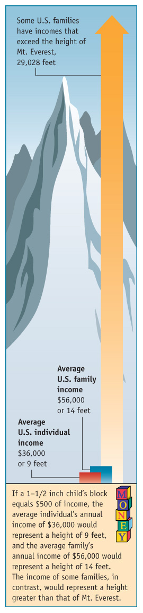
Copyright © Allyn & Bacon 2009

Slide 32
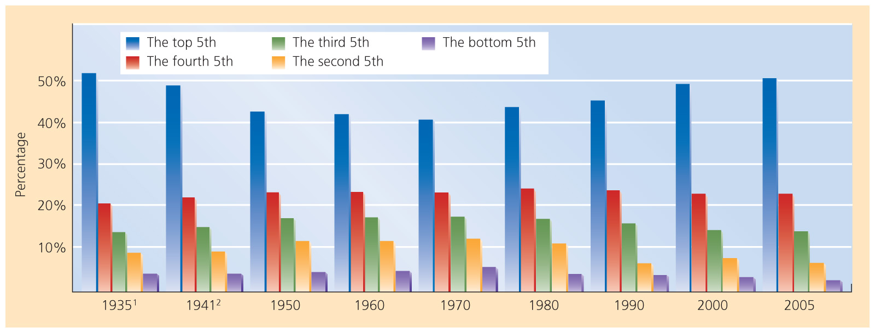
Copyright © Allyn & Bacon 2009

Slide 33
Marx and Weber – Social Class
Marx – Social Class is divided into the bourgeoisie (those who control the means of production) and the proletariats (those who are exploited by the bourgeoisie)
Weber-Social Class is defined as people who share similar levels of wealth, power, and prestige

Slide 34
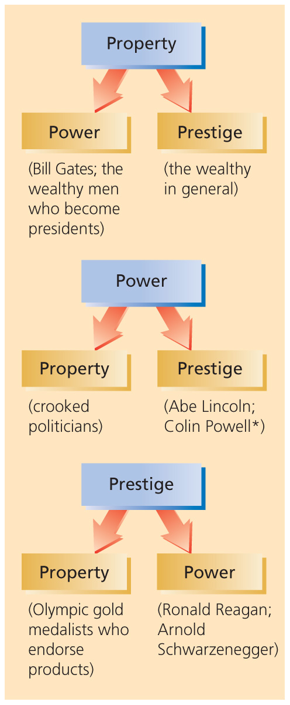
Copyright © Allyn & Bacon 2009

Slide 35
The upper social class
Only 3-4% of the population
    Inherited wealth
    Old money
    Earned/New money is still excluded from “old money clubs”
  < $100,000.
  WASPS (White Anglo Saxon protestants)

Slide 36
The Middle class
40-50%
Greatest influence on popculture and media trends
  TV shows
  Most commercials advertising is aimed at the middle class.

Slide 37
The Middle class
The upper middle class
  $50-100,000 per year and accumulate property
  Post graduate degrees
  White collar workers
The lower middle class
  $30-50,000 per year
  Less prestigious occupation
  Most own a home

Slide 38
The Working class
$15-30,000 per year
½ own homes
They are vulnerable to financial problems brought on by unemployment
1/3 of the population is considered working class
Blue collar jobs
  Less satisfaction, less security, fewer benefits

Slide 39
The lower class
The poor in this country tend to be the hardest workers (sometimes working 2 or 3 jobs)
> $15,000
35.7 million people are classified as poor in this country
Children rarely break the cycle of poverty

Slide 40

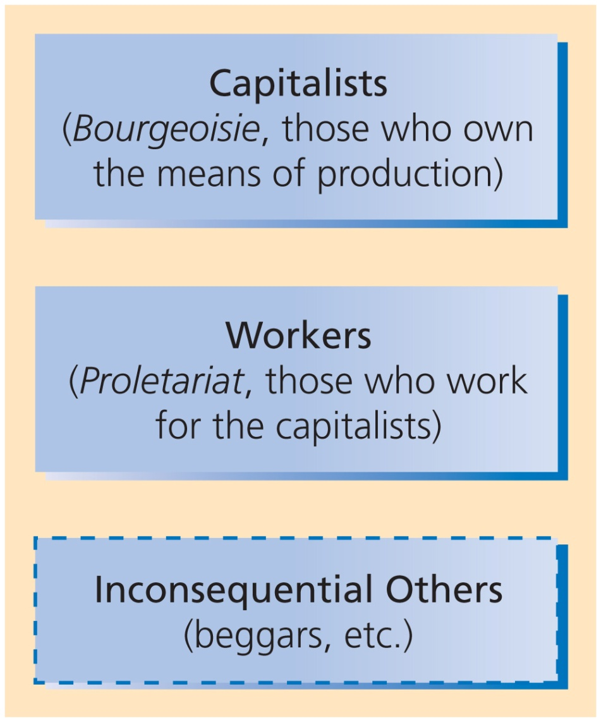
Copyright © Allyn & Bacon 2009

Slide 41
Status Consistency and Status Inconsistency
When a person has the same levels of wealth, power, and prestige they are status consistent
When a person ranks higher on one level of social class and low on another level they are status inconsistent
  People who are status inconsistent are more likely to be politically active

Slide 43
Consequences of Social Class
Family Life
  Choice of Husband or Wife
  Divorce
Education
Religion
Politics
Mental Health
Physical Health

Slide 44
What is a Family?
In U.S. - One Woman, Man, and Children
Other Cultures Polygamy and Polyandry
Approved Group into which a Child is Born?

Slide 45
Family Defined
“A family consists of people who consider themselves related by blood, marriage, or adoption.”

Slide 46
Family Can Be...
Nuclear
Extended
Family of Orientation
Family of Procreation

Slide 47
What is Marriage?
Until Recently…Taken for Granted
Acceptance of Same-Sex Marriages
Must be Alive?

Slide 48
What is Marriage?
“Marriage is a group’s approved mating arrangement…usually marked by a ritual.”

Slide 49
Common Cultural Themes
Families Establish Patterns of…
Mate Selection
Descent
Inheritance
Authority
  Patriarchy
  Matriarchy
  Egalitarian

Slide 50
Marriage and Family
Functionalist Perspective
Economic Production
Socialization of Children
Care of Sick and Aged

Slide 51
Marriage and Family
Functionalist Perspective
Recreation
Sexual Control
Reproduction

Slide 52
Marriage and Family
Functionalist Perspective
Functions of the Incest Taboo
Isolation and Emotional Overload

Slide 53
Marriage and Family
Conflict Perspective
Struggles between Wives and Husbands
Power Struggle over…
  Housework
  Child Care
  Money
  Attention
  Respect
  Sex

Slide 54
Marriage and Family
Symbolic Interaction
Gender, Housework, and Child Care
Gender Division of Labor

Slide 56
The Family Life Cycle
Love and Courtship in Global Perspective
Marriage
  Social Channels of Love and Marriage
  Homogamy

Slide 57
The Family Life Cycle
Childbirth
Marital Satisfaction Decreases
Additional Complications
Is marriage good for your health?
Does having children make you unhappy?

Slide 58
The Family Life Cycle
Child Rearing
Married Couples and Single Mothers
Day Care
Nannies
Social Class

Slide 59
The Family Life Cycle
Family Transitions
Adultolescents and the Not-So-Empty Nest
Widowhood

Slide 60
Diversity in U.S. Families
One-Parent Families

Slide 61
Diversity in U.S. Families
One-Parent Families
Families Without Children

Slide 63
Diversity in U.S. Families
Gay and Lesbian Families
One-Parent Families
Families Without Children
Blended Families

Slide 64
Trends in U.S. Families
Postponing Marriage and Childbirth

Slide 66
Trends in U.S. Families
Postponing Marriage and Childbirth
Cohabitation

Slide 68
Trends in U.S. Families
Postponing Marriage and Childbirth
Cohabitation
Unmarried Mothers

Slide 69
Trends in U.S. Families
The Sandwich Generation & Elder Care
Postponing Marriage and Childbirth
Cohabitation
Unmarried Mothers
Grandparents as Parents

Slide 70
Two Sides of Family Life
The Bright Side - Successful Marriages
Spouse is Best Friend
Like Spouse as Person
Think Marriage is Long-Term Commitment
Believe Marriage is Sacred

Slide 71
Two Sides of Family Life
The Bright Side - Successful Marriages
Agree with Spouse Aims and Goals
Believe Spouse Grown More Interesting
Want Relationship to Succeed
Laugh Together

Slide 72
Happy Families
Spend a Lot of Time Together
Are Quick to Express Appreciation
Committed to Promoting Mutual Welfare
Talk and Listen a Lot
Are Religious
Deal with Crises Positively

Slide 73
Two Sides of Family Life
The Dark Side
Spouse Battering
Child Abuse
Marital or Intimacy Rape
Incest

Slide 74
Child Abuse and Neglect
The physical, emotional/psychological or sexual maltreatment of children.
  Majority in home
    Group organizations
    Churches
    Schools
    Daycare

Slide 75
The children’s defense fund
Every ten seconds a child is reported abused or neglected
Every fourteen seconds a child is arrested
Every two hours a child is killed by firearms
Every 4 hours a child commits suicide
Every 5 hours a child dies from abuse or neglect

Slide 76
4 primary categories
Neglect
Physical
Psychological/emotional
Sexual

Slide 77
Neglect
3 categories
  Physical neglect – food, clothing, hygiene…
  Educational – failure to enroll in school
  Emotional- inadequate nurturing or affection

Slide 78
Physical abuse
Wide range
  Striking
  Burning
  Shaking
  Pinching
  Pulling hair or ears
  Cutting off the child’s air

Slide 79
Sexual abuse
Any behavior involving penetration
Fondling
Violations of privacy
Exposing children to adult sexuality
Expoitation

Slide 80
Psychological or Emotional
Least understood of all child abuse
  Doesn’t leave any marks
  Cruelest and most destructive type of abuse
Verbal abuse
Withholding of affection
Extreme punishment
Rejecting
Terrorizing
Isolating

Slide 81
Parental characteristics
The abusing father was physically punished by his parents and his father physically abused his mother
The parents believe in corporal punishment for children and wives

Slide 82
Parental characteristics
Interspousal violence
The parents have low self esteem
The parents have unrealistic expectations of the children

Slide 83
Incest
Defined as sexual relations between persons) often within the immediate family such that it is either illegal or socially taboo
  Father-Daughter; Stepfather-Daughter is most commonly reported

Slide 84
The Development of Modern Education
Education in Earlier Societies
Education Consisted of Informal Learning
Education was Equivalent to Acculturation
Education is a Group’s Formal System of Teaching

Slide 85
Sociology of Education
A central sociological principal of education is that a nation’s education reflects its culture

Slide 86
The Development of Modern Education
In U.S. Jefferson and Webster Proposed Universal Schooling
Uniform National Culture Through Education
Rich Educated, Poor Not
Industrialization and Universal Education

Slide 87
Functional illiteracy
Inability to read basic signs or maps, complete simple forms, or carry out many of the tasks that require reading.
  Functionally illiterate adults are disproportionately poor, older than age 55, uneducated, and members of racial or ethnic minority groups.

Slide 88
Education in global perspective
A social institution that is common to all societies
Education related to nations economy

Slide 89
Education in global perspective
A social institution that is common to all societies
Credential societies – diplomas
  Determine job eligibility
Diplomas serve as a sorting device
Education related to nations economy

Slide 90
Cross-Cultural Variation In Education
Worldwide:
  Over 100 million children have little or no access to schools.
  Over 860 million adults are illiterate.

Slide 91
The Development of Modern Education
Horace Mann Proposed “Common Schools” Supported by Taxes
By 1918, All States had Mandatory Education
Industrialization and Universal Education

Slide 92
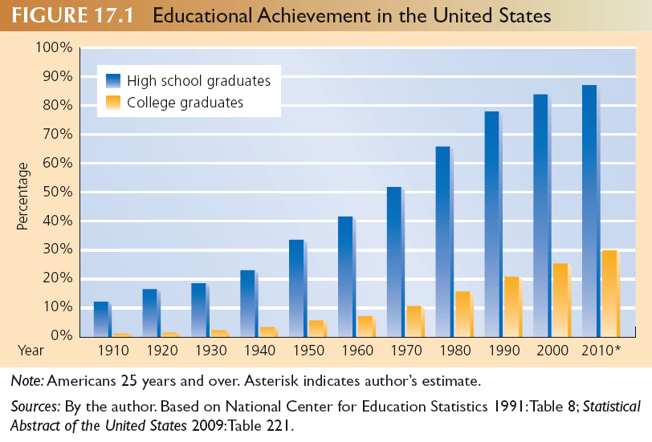

Slide 94
Education in the U.S.
3 contemporary education issues
Curriculum- range of topics the school offers
Funding- property taxes, private schools, grants, and government loans
Control- the sate has most of the control

Slide 95
Functionalist perspective
Providing social benefits
  Manifest vs. latent functions
    Positive outcomes that were intended and those that were not
  Teaching knowledge and skills
  Cultural transmission of values
    Individualism, competition, curriculum, the architecture of the school and the way your day is structured

Slide 96
Functionalism
Social integration
  Molding students into a cohesive unit
  Socializing into main stream culture
Gate keeping, determining which people will enter which occupations, is another function of society – using diplomas?
  Tracking students
  Schools facilitate social placement

Slide 97
Conflict perspective: perpetuating social inequality
Educational system reproduces social structure
  Helps the members of the elite to maintain their dominance

Slide 98
Conflict perspective
Perpetuating social inequality
  The hidden curriculum
    Unwritten rules of behavior and attitude
  Tilting the tests- discrimination by IQ
    They reflect a cultural bias (by not looking a culturally acquired knowledge)
  Stacking the deck: unequal funding
    Local property taxes

Slide 99
Conflict perspective
Social class
  Passing the privileged (Saints and the Roughnecks)
Race and ethnicity
  Whites are more likely to complete high school, go to college, and get a degree than African Americans or Latinos

Slide 101
Conflict Perspective:
Perpetuating Social Inequality
Correspondence Principle
Family Background

Slide 103
Symbolic Interactionist Perspective
Concerned with the individual and small-group issues in education:
  Teacher-student interactions
  Student self-esteem

Slide 104
Symbolic Interactionist Perspective
  Self-fulfilling prophecy - Occurs when people act in a manner consistent with the expectations of others.

Slide 105
The Self-fulfilling Prophecy
Rosenthal and Jacobson experiment:
Five random elementary school students were labeled as having superior intelligence and ability.
Teachers expected them to do well and treated them in a way that encouraged better school performance.

Slide 106
Symbolic interactionist perspective teacher expectations and the self fulfilling prophecy
Fulfilling teacher expectations- significant in what students learn
  The Rist Research- I am expecting an ‘A’
    The higher the expectation the better the result
  George Farkas and Teacher expectations
    If you act interested in what I am saying you are likely to get a better grade

Slide 107
Symbolic interactionist perspective teacher expectations and the self fulfilling prophecy
Fulfilling teacher expectations- significant in what students learn
  The Rist Research- I am expecting an ‘A’
    The higher the expectation the better the result
  George Farkas and Teacher expectations
    If you act interested in what I am saying you are likely to get a better grade

Slide 108
The Self-fulfilling Prophecy
Rosenthal and Jacobson experiment:
Five random elementary school students were labeled as having superior intelligence and ability.
Teachers expected them to do well and treated them in a way that encouraged better school performance.

Slide 109
First impressions are lasting impressions
How does the SFP work in education?
  5 step model
The teacher forms expectations
Based on these expectations, the teacher acts in a different manner

Slide 110
First impressions are lasting impressions
The teacher tells the student (loud and clear) what behavior and what achievement the teacher expects
If this treatment is consistent, it will tend to shape the student’s behavior and achievement

Slide 111
First impressions are lasting impressions
With time the student’s behavior will and achievement will conform more and more closely to that expected of him or her

Slide 112
Teachers act on expectations
Climate: the socio-emotional mood or spirit created by the person holding the expectation is often communicated nonverbally
  Smiling and nodding more often
  Providing greater eye contact
  Leaning closer to the student

Slide 113
Teachers act on expectations
Feedback: providing both affective and cognitive information
  More praise and less criticism of higher expectation student
  More detailed as well as higher quality feedback as to the correctness of higher-expectation students’ responses

Slide 114
Teachers act on expectations
Input: teachers tend to teach more to students of whom they expect more
Output: teachers encourage greater responsiveness from those students of whom they expect more through their verbal and nonverbal behaviors

Slide 115
Race and Ethnicity
Because race and ethnicity are closely tied to socioeconomic status, race or ethnicity alone can determine school success.

Slide 116
Race and Ethnicity
In 2003, 41% of white fourth graders were reading at grade level, compared to 15% of Hispanics and 13% of blacks.

Slide 117
Race and Ethnicity
Some educators advocate bilingual education, teaching children in English and in their native language.

Slide 118
Educational Attainment by Race, Ethnicity, and Sex, 1970 and 2003
4 or more years of high school | 1970 |  | 2003
 | Males | Females | Males | Females
White | 54 | 55 | 84.5 | 85.7
Black | 30.1 | 32.5 | 79.6 | 80.3
Hispanic | 37.9 | 34.2 | 56.3 | 57.8
Asian | NA | NA | 89.5 | 86
Total | 51.9 | 52.8 | 84.1 | 85

Slide 119
Educational Attainment by Race, Ethnicity, and Sex, 1970 and 2003
4 years of college or more | 1970 |  | 2003
 | Males | Females | Males | Females
White | 14.4 | 8.4 | 29.4 | 25.9
Black | 4.2 | 4.6 | 16.7 | 17.8
Hispanic | 7.8 | 4.3 | 11.2 | 11.6
Asian | NA | NA | 53.9 | 46.1
Total | 13.5 | 8.1 | 28.9 | 25.7

Slide 120
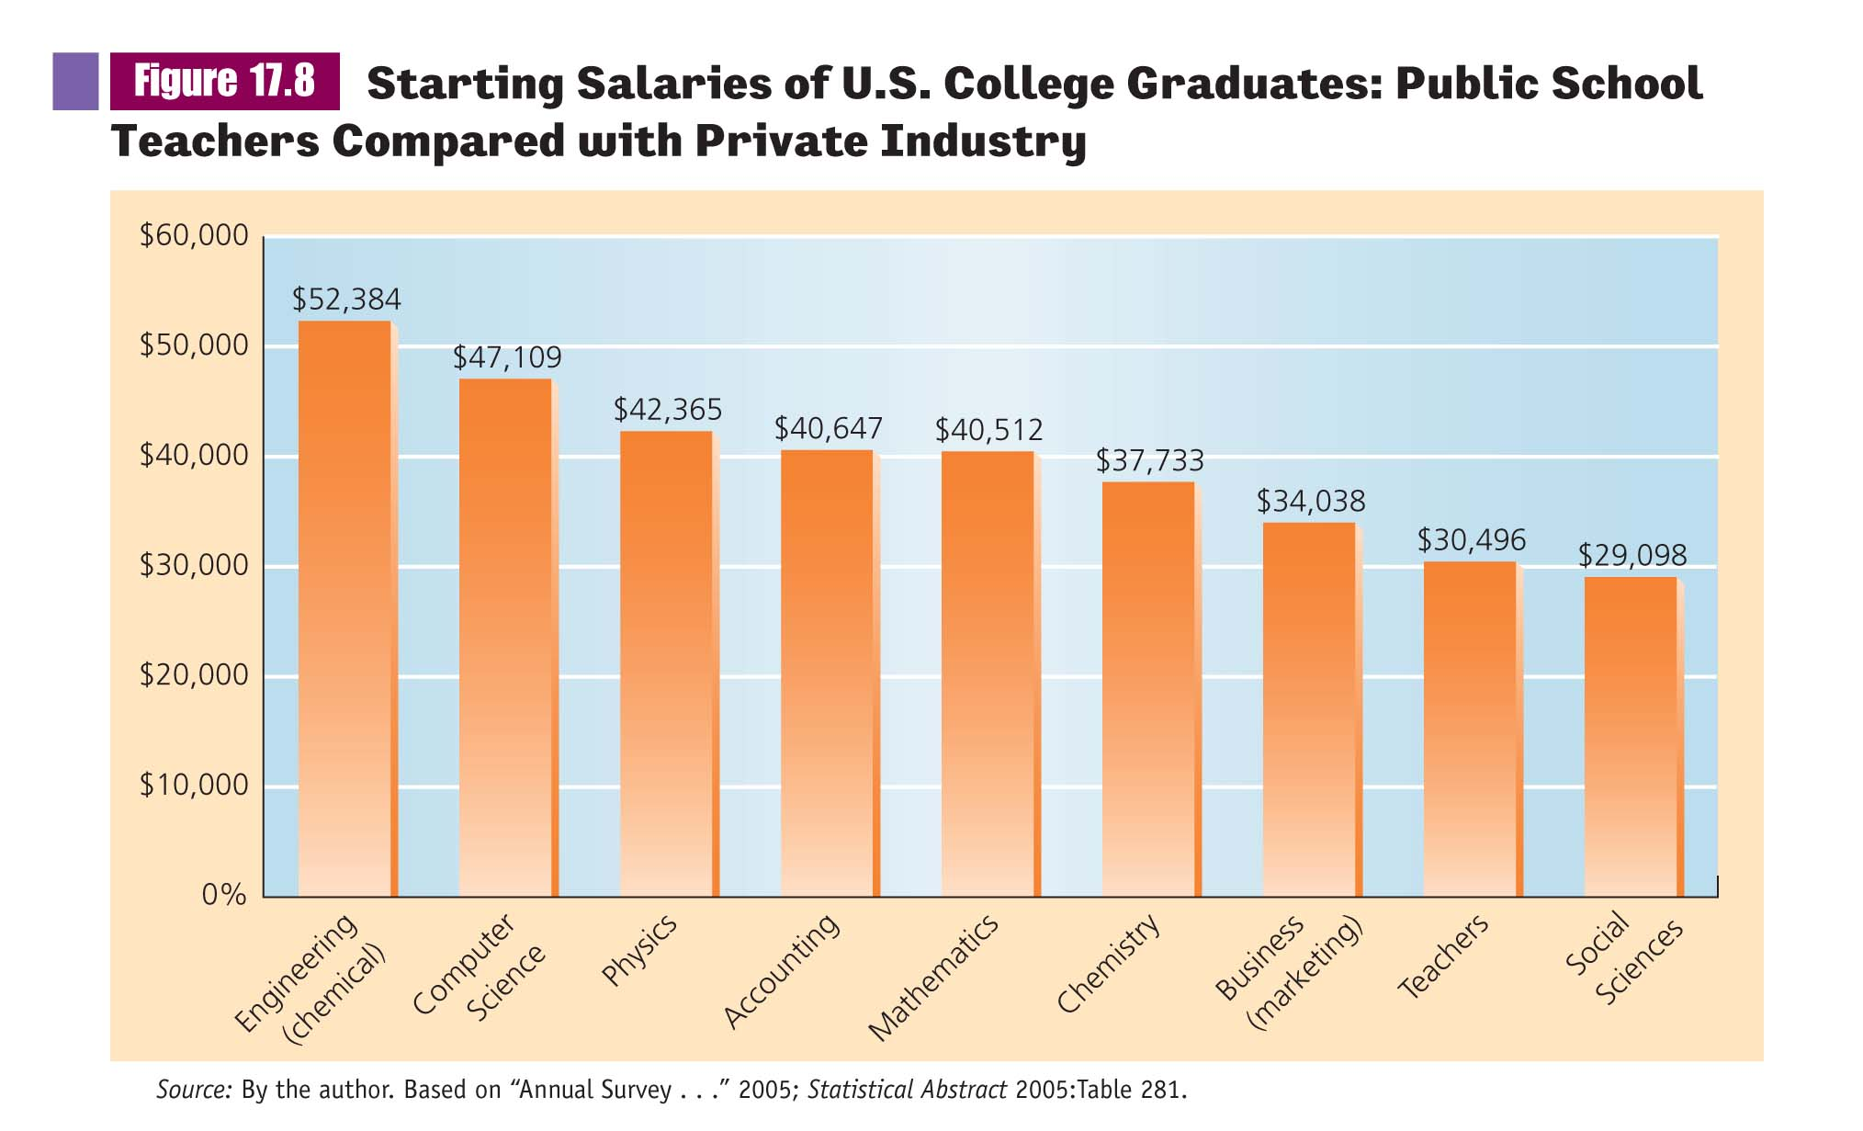

Slide 121
Problems in U.S. Education
Rising tide of mediocrity
Cheating on SATs
Grade inflation, social promotion, Functional illiteracy
The influence of peer groups
Violence in schools

Slide 122
Solutions: Safety and Standards
Secure learning environment
Higher standards

Slide 123
What is Religion?
Emile Durkheim said, “A religion is a unified system of beliefs and practices relative to sacred things.”

Slide 124
The functionalist perspective
8 Functions of religion
  Questions about ultimate meaning (the purpose of life, why do people suffer?)
  Provides emotional support
  Shared values and perspectives
  Provides guidelines for life

Slide 125
The functionalist perspective
  5. Controlling behavior
  6. Helping people adapt to new environments
  7. Providing support for the government
  8. Spearheading social change on occasion

Slide 126
Functional Equivalents of Religion
Organizations Like Alcoholics Anonymous
Psychotherapy
Humanism
Transcendental Meditation
Political Parties

Slide 127
The functionalist perspective
Dysfunctions of religion
  Religious persecution
  War and terrorism

Slide 128
Dysfunctions of Religion Terrorists and the Mind of God
Believe They are Under Attack
Convinced God wants Action
Believe Violence will Resolve Issue
Convinced God has Chosen Them
Perspective Nurtured by Community

Slide 129
Symbolic Interactionist Perspective
Religious Symbols
Rituals
Beliefs
Religious Experience
Community

Slide 130
Symbolicinteractionist perspective
Religions use symbols to provide identity and social solidarity for members
  Sacred symbols evoking awe and reverence
  These symbols become a condensed way of communicating with others

Slide 131
Symbolic interaction
Rituals and beliefs
Ceremonies or repetitive practices helping unite people by creating a closeness with one another
A belief may be vague or specific (its our values and our picture of the world)

Slide 132
Symbolic interaction shared meanings
It provides the basis for mutual identity and establishes norms that govern the behavior of members
Not only are members bound together by shared beliefs and rituals, but they are also separated from those who do not share their world

Slide 133
Conflict perspective
Marx’s Opium of the people; Marx was an Atheist
  He believed that oppressed workers escaped into their religion
Legitimization of social inequalities
  Thoughts of future happiness would reduce the oppressed workers from rebeling

Slide 134
Religion and the Spirit of Capitalism
Weber- unlike other conflict theorists, he saw religion’s focus on an after life lead to social change
  After life (social force?)

Slide 135
Cult
A new religion with few followers, whose teachings and practices put it at odds with dominant culture and religion
  Most popular Religions started this way
  Most cults fail
  Begin with Charismatic leader

Slide 136
Cult
Each cult meets with rejection from society
  Seen as threat to the dominant culture
The cult demands intense commitment and its followers confront a hostile world
  Heavens Gate and the mass suicide (1997)

Slide 137
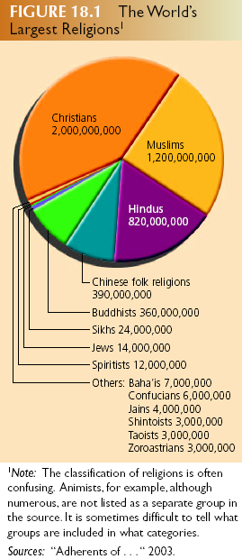
The World’s Major Religions
Source: “Adherents of…” 2003.

Slide 138
Religion in U.S.
Characteristics of members
  Social Class
  Race and Ethnicity
  Age

Slide 139
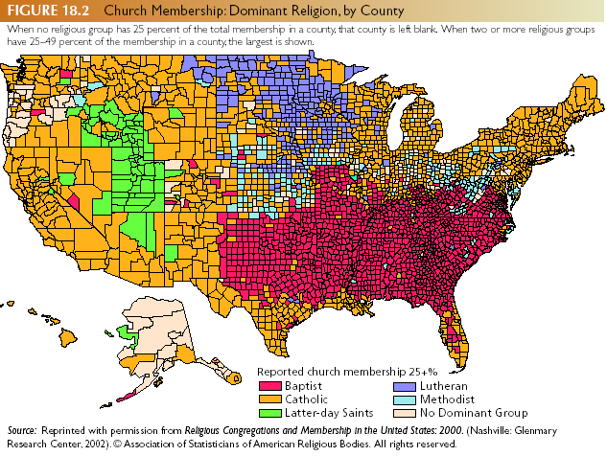

Slide 140
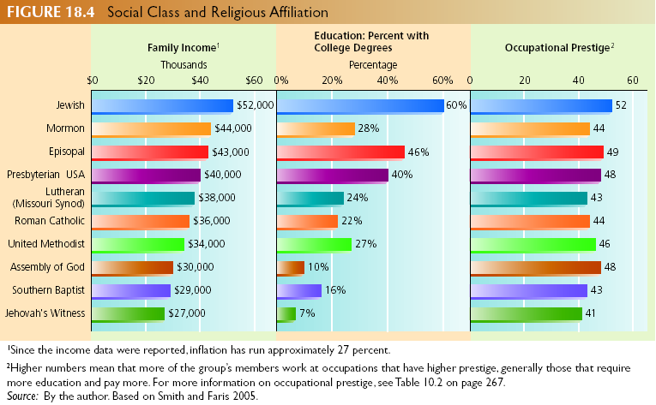

Slide 141
Religion in the U.S.
Characteristics of Members
Social Class
Race and Ethnicity

Slide 143
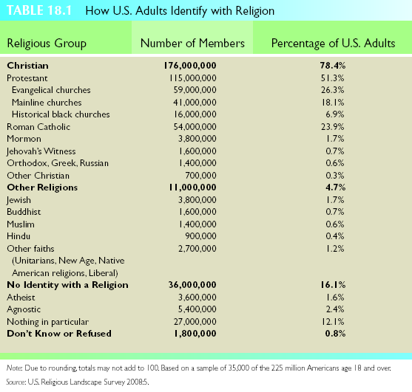

Slide 144
Religion in the U.S.
Characteristics of Religious Groups
Diversity
Pluralism and Freedom
Competition and Recruitment
Commitment

Slide 145
Religion in the U.S.
Characteristics of Religious Groups
Toleration
Fundamentalist Revival
The Electronic Church

